Slide 1
Supplementing the Standard American Diet:
The Top 5 Nutrients Most Patients Need
Cherise Bludau-Branch APRN FNP-BC FAAMM

Slide 3
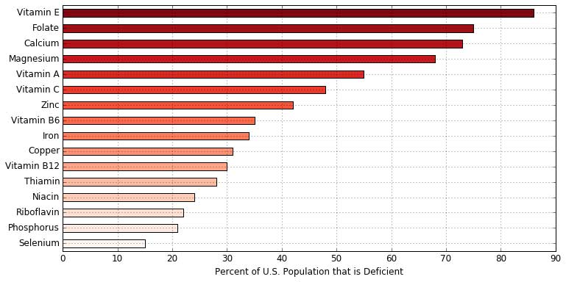
Nutrient Deficiency Prevalent in the Majority of Americans:
Key vitamins and minerals and the estimated percentage of the U.S. population deficient in them. (Source: US Department of Agriculture, 2009)

Slide 4
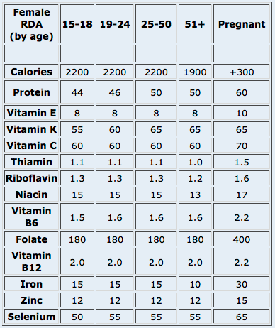
What is the RDA?
R-----D----A-------
Only enough vitamins to keep us from having a deficiency syndrome
RDA has nothing to do with Optimal Health

Slide 5
Cherise’s Daily Top Five
Multivitamin
Omega 3s / Fish Oil
Magnesium
Probiotics
Vitamin D3

Slide 6
How Does Your Multivitamin Stack Up?
One-a Day Vitamins Do Only Half the JOB!
Most of the water-soluble vitamins and minerals are out of you body in 4 hours
Vitamins attached to HCl carrier molecule
Tablets are packed tight-capsules optimal choice
Do to stress, environmental toxins, illness, and low nutrients in our food, we need 24-hour coverage.

Slide 7
Vitamin Tips of the Trade
Capsules are the Best
Liquids second, tablets last
Multiple vitamins should be dosed twice daily.
“You can’t eat once a day and feel good”
Vitamins should be attached to “carrier molecules that will enter the body.
Optimal (higher) Dosing

Slide 8
Look for High Quality Fish Oil
Should be triple distilled to remove ALL PCBs and Mercury.
Rule of thumb 600mg of ACTIVE ingredients PER capsule.
Patients should not taste fish or cause the patient to burp.
Capsules do not need to kept in freezer.

Slide 10
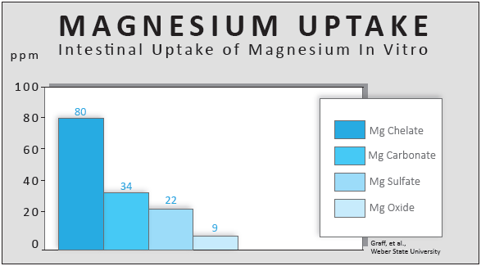
Magnesium Absorption
Magnesium Chelate Absorption
8.8 times greater than magnesium oxide
5.6 times greater than magnesium sulfate
2.3 times greater than magnesium carbonate

Slide 11
We have 10 times more bacteria than the number of cells in our body!

Slide 12
Benefits of Probiotics
Promising research has shown potential benefits in the prevention or treatment of:
Diarrhea
Irritable Bowel Syndrome
Ulcerative colitis
Crohn’s disease
H. pylori (ulcers)
Vaginal infections
UTIs
Recurrence of bladder cancer
C. diff infections
Pouchitis
Eczema in children

Slide 13
Vitamin D Deficiency
41.6% of adults in the US are deficient.
This number goes up to 69.2% in Hispanics a
82.1% in African-Americans
Ask for your level to be measured
Prevalence and correlates of vitamin D deficiency in US adults. Nutr Res. 2011 Jan;31(1):48-54. doi: 10.1016/j.nutres.2010.12.001.

Slide 14
Vitamin D Deficiency Symptoms
Hair Loss
Changes in mood, including depression or anxiety
Frequent fractures
Slow wound-healing
Loss of bone density
Muscle weakness
New or worsening high blood pressure
Constant fatigue
Chronic pain
Infertility
Decreased endurance

Slide 15
Cherise’s Daily Top Five
Multivitamin
Omega 3s / Fish Oil
Magnesium
Probiotics
Vitamin D3

Slide 16
Would you like a plan specific to your individual needs?
Cherise Bludau-Branch APRN FNP-BC FAAMM
cherisebb@centraldrug.net
P:361-575-4713

